Slide 1

Data Analysis and Insights for page Optimization & User Engagement XYZ Inc.
Muthukumaran A

Slide 2
Introduction to the Dataset
Objective
The dataset provided contains user data from various sources, including regions, customer demographics, product information, and marketing campaign details.
The data includes information on user acquisition, traffic acquisition, user engagement, and conversion metrics for different channel groups.
The objective of this analysis is to identify critical factors influencing user engagement and insights for different page optimization strategies.
The goal is to improve user installation and engagement on the website, ultimately optimizing page performance for XYZ Inc.

Slide 3
Data Exploration
User Acquisition: This table explains how the new users are acquired.
Traffic Acquisition: This table explains the user traffic, engagement and conversions.
Event Report: This table contains data on events or actions taken by users on the platform, such as clicks, views, or interactions with specific features.
Conversion Report: This table contains data related to user conversions, such as the number of users who completed a desired action (e.g., making a purchase, signing up for a service).
Pages and Screen Report: This table contains data related to the pages or screens users interact with, including metrics like page views, time spent on each page, or bounce rate.

Slide 4
Data Exploration
Demographic Report: This table contains demographic data about users location(Country).
City-wise Report: This table contains data on user activity broken down by city or location.
Gender Report: This table contains data on user activity broken down by gender.
User by Interest: This table contains data on user interests or preferences, which could be used for targeted marketing or content recommendations.
User by Language: This table contains data on user language.
User by Age: This table contains data on user activity broken down by age groups.
Google Ads Report: This table contains data related to advertising campaigns run through Google Ads.

Slide 5
Key Factors
User Acquisition Channel: Identifying the channels through which users are acquired (e.g., organic, paid) can help prioritize marketing efforts and allocate resources effectively.
User Demographics (e.g., Age, Gender, Location): Analyzing demographic data can help tailor content and offerings to specific user segments, improving engagement and conversion rates.
Engagement Metrics (e.g., Average engagement time, Engaged sessions/ Views per user): Monitoring engagement metrics can indicate how users are interacting with the app and website, highlighting areas for improvement in user experience.
Conversion Metrics (e.g., Conversions, Cost per Conversion): Understanding conversion metrics can help optimize conversion strategies and increase the number of installations and engagements.
Marketing Campaign Details (e.g., Campaign Name, Conversion Rates, ROI): Evaluating the performance of past marketing campaigns can help identify successful strategies and areas for improvement.

Slide 6
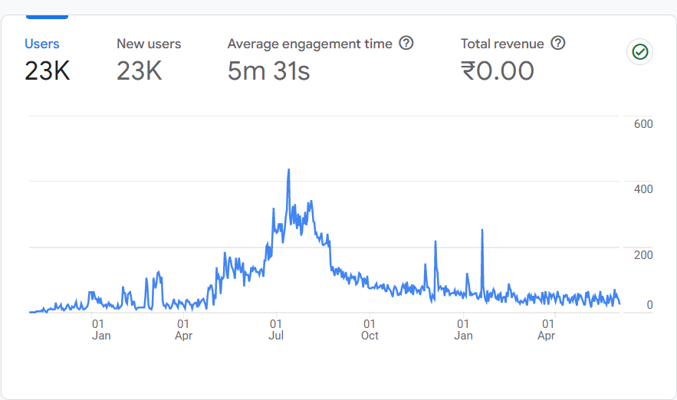
Report snapshot
Inferences:
Steady Growth: Healthy user base and consistent new user acquisition.
Engagement: Users find the platform engaging and valuable.
Seasonal Variation: More new users between July 01 and October 01.
Recommendations:
Leverage Seasonal Peaks: Focus marketing efforts during peak acquisition months.
Enhance Engagement: Introduce new features or content to further engage users.
Retention Strategies: Implement strategies to retain existing users.
Monitor Trends: Continuously track user metrics to adapt strategies.
Summary insights:
User base: stable at 23,000 users.
New users: consistently 23,000, indicating effective acquisition.
Engagement: average time of 5m 31s, indicating strong user interest.

Slide 7
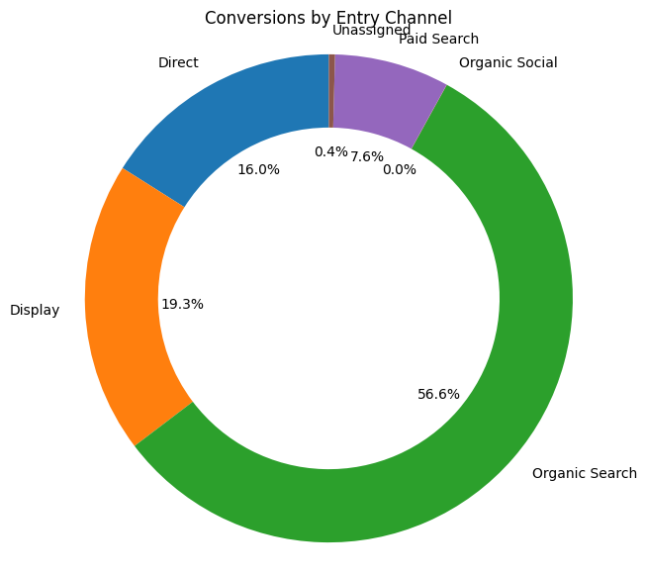
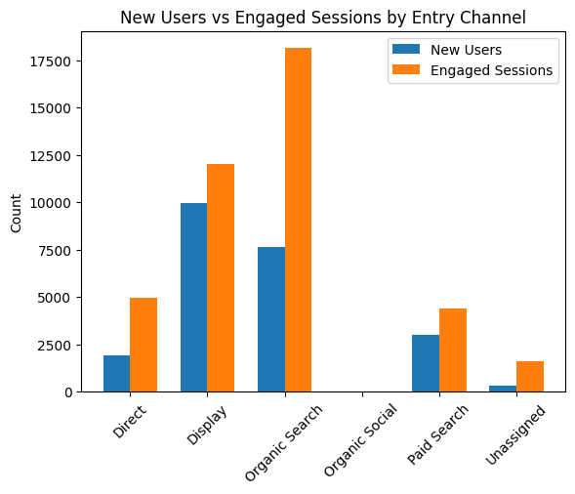
User Acquisition Analysis
1. User Acquisition Channels:
Organic Search: High new users, high engagement & significant time spent with 56.6% conversion rate.
Display: High new users, low engagement with second best conversion rate of 19.3%.
Paid Search: Moderate new users, lower engagement.
Direct: Fewer new users, high engagement and time spent.
Organic Social: Very few new users, low engagement.
2. Engagement Metrics:
Engagement Rate: Organic Search and Unassigned are highest.
Engaged Sessions per User: Direct and Unassigned are highest.
Average Engagement Time: Direct users spend most time.
3. Conversion Metrics:
Conversions: Organic Search, Display and Direct are highest.
Total Revenue: Organic Search generate most revenue.

Slide 8
RECOMMENDATIONS
Focus on High-Performing Channels:
Allocate more resources to channels like Organic Search and Direct, which show high engagement rates and Display which show high conversion metrics.
Optimize Engagement:
Improve engagement strategies for channels like Display to increase user interaction and conversion rates.
Explore Untapped Potential:
Investigate the low-performing channels like Organic Social to understand why they have low engagement and explore opportunities for improvement.

Slide 9
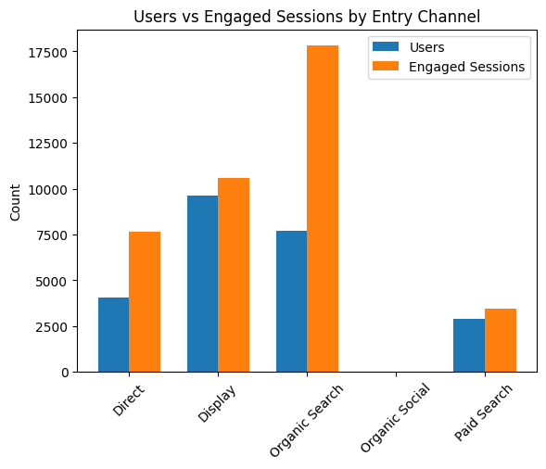
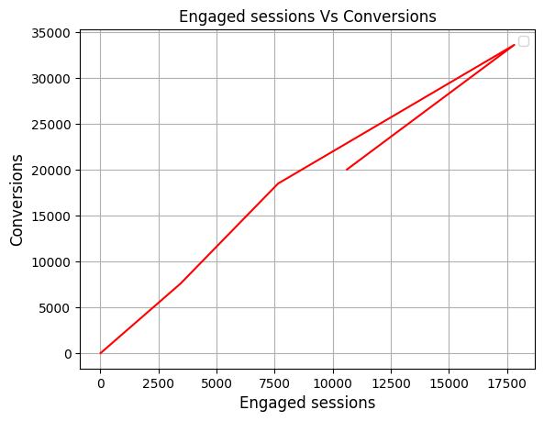
Traffic Acquisition Analysis
Organic Search:
High number of users and sessions, with very high engagement rates.
Users spend a significant amount of time per session.
Display:
Moderate number of users, high engagement, and average engagement time per session.
Highest number of engaged sessions and conversions.
Direct:
Moderate number of users and sessions, with high engagement rates.
Users spend a considerable amount of time per session.
Paid Search:
Lower number of users and sessions, with moderate engagement rates.
Average engagement time per session is moderate.
Organic Social:
Very low number of users and sessions, with low engagement rates.
Average engagement time per session is low.

Slide 10
Recommendations
Display: Since Display has a high number of engaged sessions and conversions, continue to invest in Display advertising as it seems to be effective in driving user engagement and conversions.
Organic Search: Organic Search is performing well with high engagement rates and a significant number of engaged sessions. Focus on optimizing SEO strategies to maintain and improve this performance.
Direct: Direct traffic has a high number of engaged sessions and a relatively high average engagement time per session. Consider implementing personalized content or offers for direct visitors to further enhance engagement.
Paid Search: While Paid Search has a moderate number of users and sessions, its engagement rates and average engagement time per session are relatively low. Review and refine targeting and ad creatives to improve these metrics.
Organic Social: Organic Social has a low number of users and sessions, indicating that the current social media strategies may not be effective. Consider revising the social media strategy to increase user engagement and drive more traffic from social channels.

Slide 11
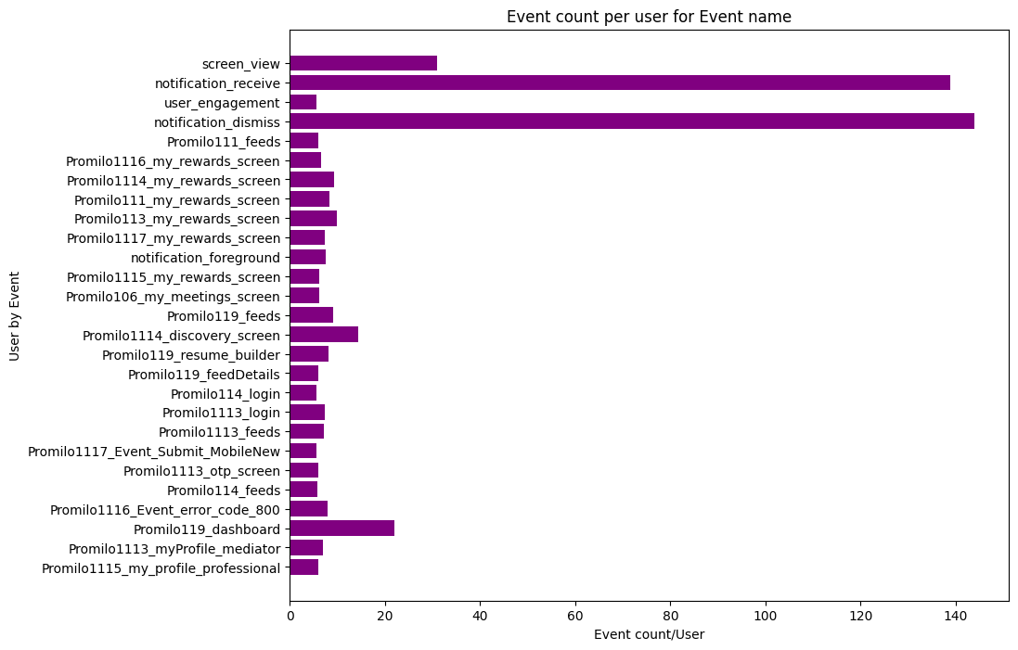
Event Report analysis
Users spend the most time on the Notification Receive and Notification Dismiss events.
Screen View counts as the third most frequent event.
Other significant events include the Rewards Screen, which appears frequently.
Dashboard, Discovery Screen, and Resume Builder, where users also spend considerable time.

Slide 12
Recommendations
Focus on Notification Events: Since "Notification receive" and "Notification dismiss" are the events users spend the most time on, consider optimizing these notifications. Ensure they are relevant, timely, and valuable to the users.
Enhance Screen Views: Given that screen views are the third highest event, improving the user interface and experience of screens could further engage users.
Rewards Screen Optimization: The rewards screen appears often, indicating its importance. Ensure that the rewards offered are compelling and motivate users to engage more with the application.
Enhance Dashboard, Discovery Screen, and Resume Builder: Since users spend significant time on these screens, enhancing their functionality, usability, and content could lead to higher user engagement. Consider adding new features, updating content, or improving navigation to make these screens more appealing.
Personalization and Targeting: Use the data from these events to personalize the user experience. Tailoring notifications, rewards, and content based on user behavior can increase engagement and satisfaction.

Slide 13
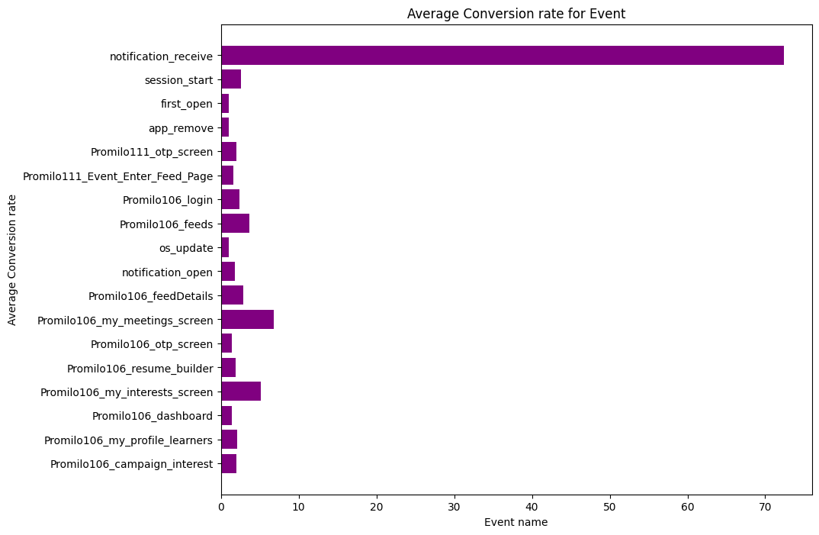
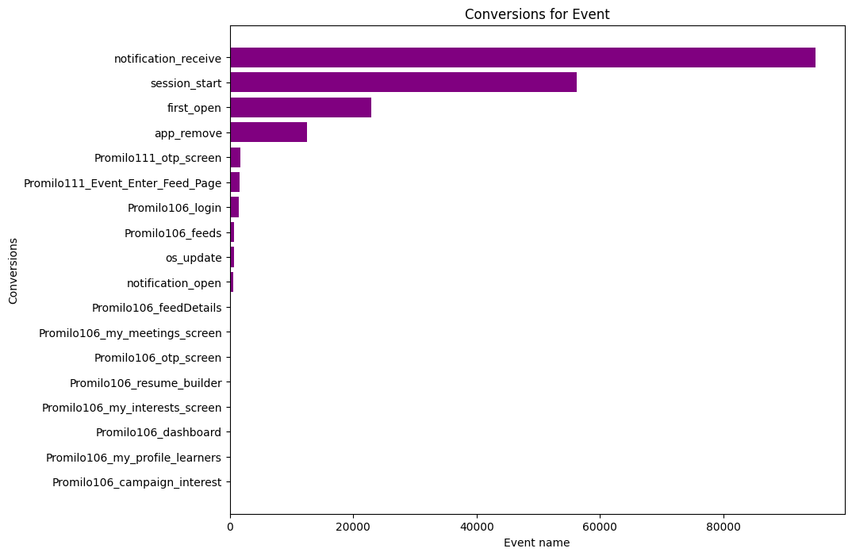
Conversion Report
"Notification Receive" has the highest conversions but a low number of total users
"Session Start" and "First Open" have high total users but low conversions.
Events like "Promilo111_OTP_Screen" and "Promilo111_Event_Enter_Feed_Page" have a moderate number of conversions and total users
Events like "Promilo106_Dashboard" and "Promilo106_My_Profile_Learners" have low conversions and total users.
"App Remove" has a high number of users but no conversions, indicating a high churn rate.
"OS Update" has a moderate number of conversions, suggesting that users who update their OS are more likely to convert.

Slide 14
Recommendations
Targeted Messaging: Analyze the characteristics of users who convert after receiving notifications. Tailor notifications to appeal to a broader audience while maintaining relevance to increase conversions among other user segments.
User Onboarding: "Session Start" and "First Open“. Improve the onboarding process to guide users towards conversion actions early in their journey.
In-App Messaging: Use in-app messaging to highlight key features or benefits to encourage users to convert after session start or first open.
Optimize User Flow: Analyze user interactions on these screens("Promilo111_OTP_Screen" and "Promilo111_Event_Enter_Feed_Page") to optimize the user flow and reduce friction points that may prevent conversions

Slide 15
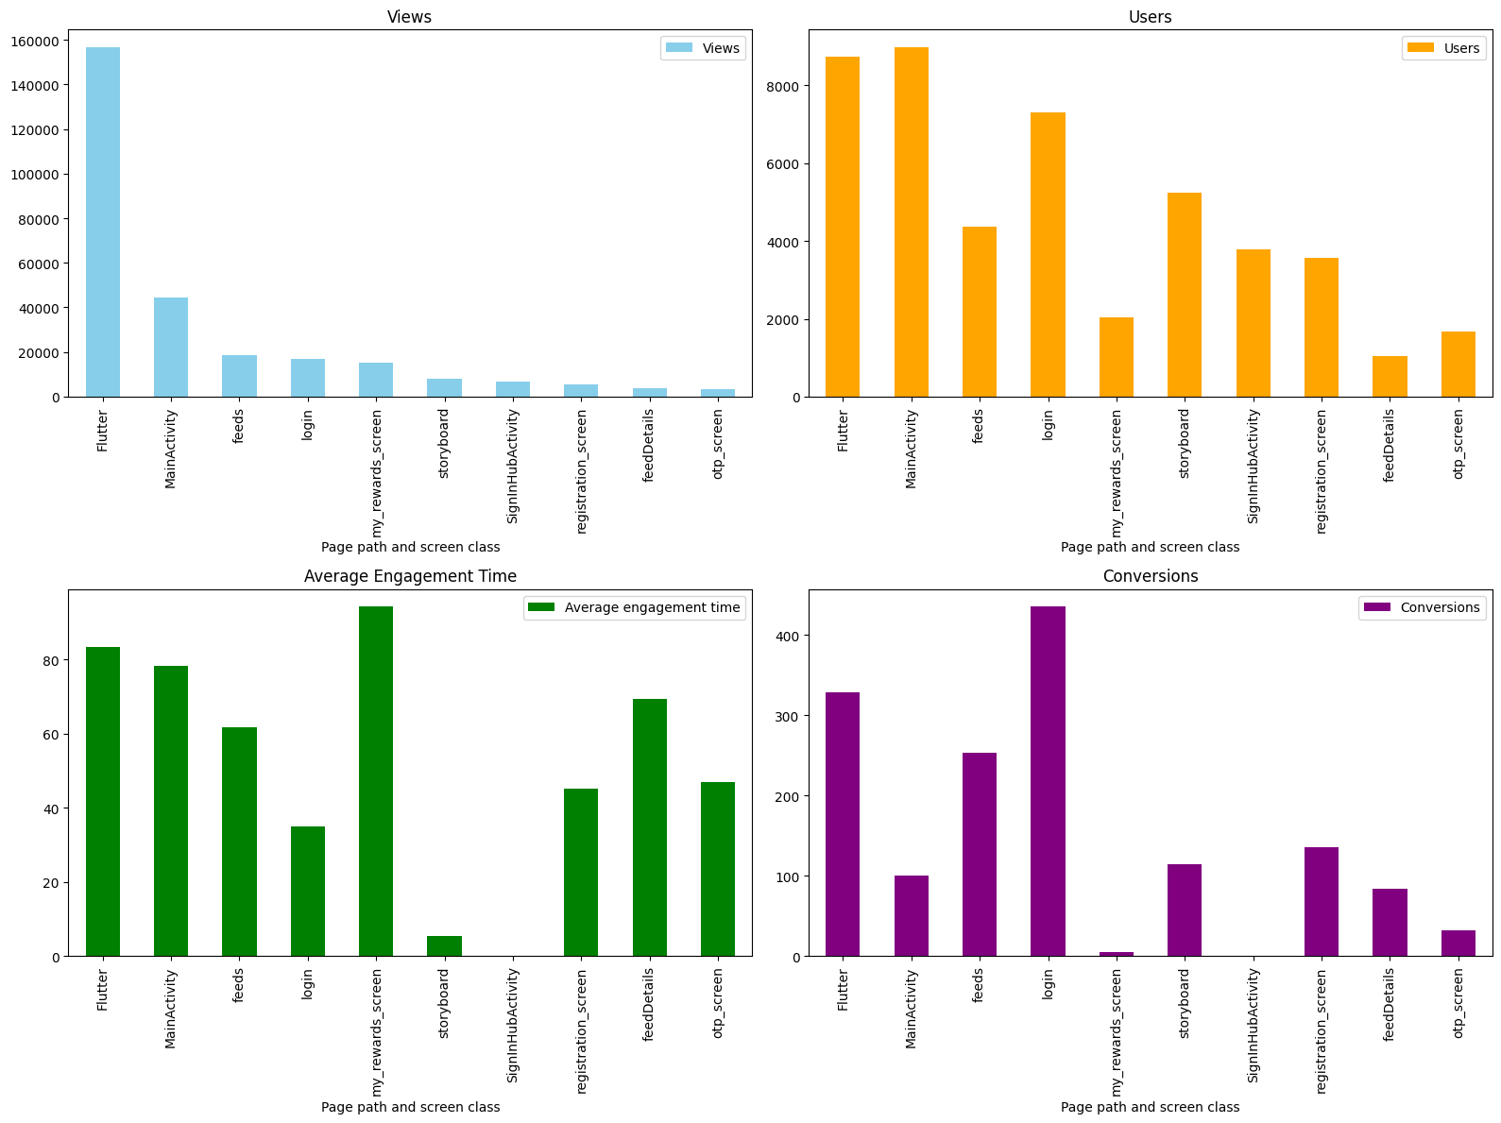
Pages & Screens Report
Flutter has the highest number of views(156708) and 18.0 views per user, accounting for 14%, indicating significant user engagement with this page path and screen class.
Main activity and feeds also have high views and users, suggesting these are important screens for users.
Login has a high number of users but relatively low conversions, indicating a potential issue with user engagement or conversion flow on this screen.
My rewards screen has a high average engagement time, suggesting that users are spending a significant amount of time on this screen.

Slide 16
Recommendations
Flutter:
Optimization: Continuously optimize this screen for performance and
user experience to capitalize on its popularity.
Main activity and feeds:
Content Strategy: Ensure these screens provide valuable content or features to maintain user engagement.
Login:
Conversion Flow & Incentives : Review and optimize the user journey on this screen to improve conversions. Offer incentives or rewards for users to complete the login process,
such as exclusive content or discounts.
My rewards screen:
Monetization Strategy: Develop a monetization strategy for this screen,
such as offering premium rewards or partnering with advertisers.

Slide 17
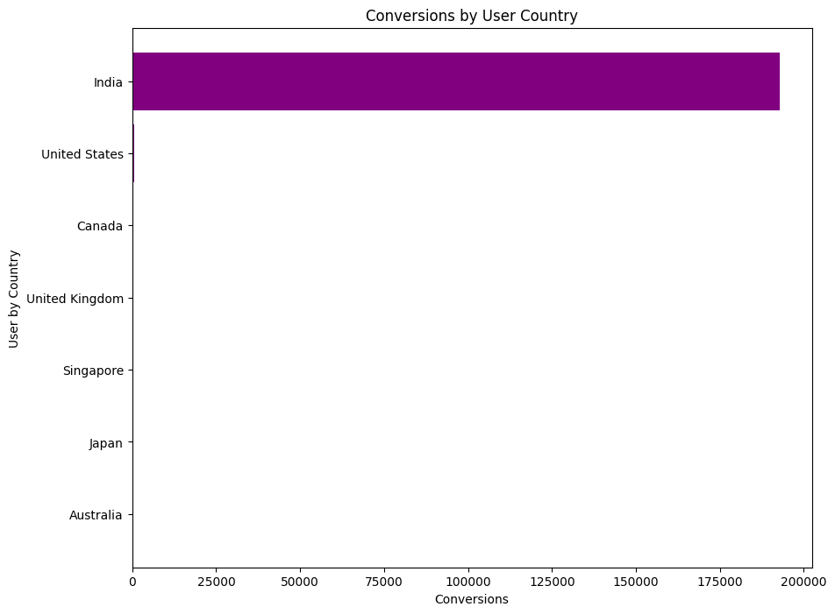
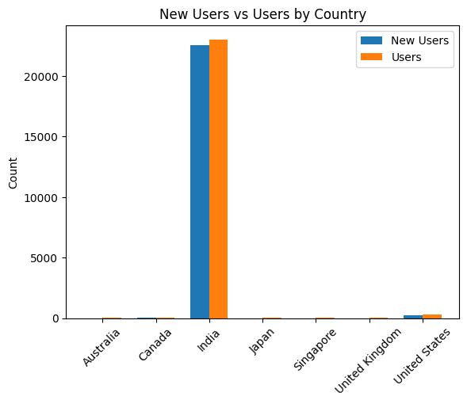
Country Analysis
India has the highest number of users, new users, engaged sessions, and event count, indicating a significant user base and high engagement with approximately 192K, constituting 99% of the dataset.
United States has a moderate number of users but a low engagement rate and average engagement time, suggesting potential issues with user retention or interaction.
Canada and United Kingdom have relatively low user numbers and engagement metrics, indicating a smaller user base or potentially less effective engagement strategies.
Singapore, Japan and Australia also show moderate engagement metrics, indicating a decent level of user interaction despite lower user numbers.

Slide 18
Recommendations
India: Focus on maintaining high engagement levels and user growth.
United States: Improve engagement strategies to increase interaction and retention.
Canada and United Kingdom: Explore ways to increase user base and engagement.
Singapore, Japan, and Australia: Continue engaging with the user base to maintain or improve current engagement levels.

Slide 19
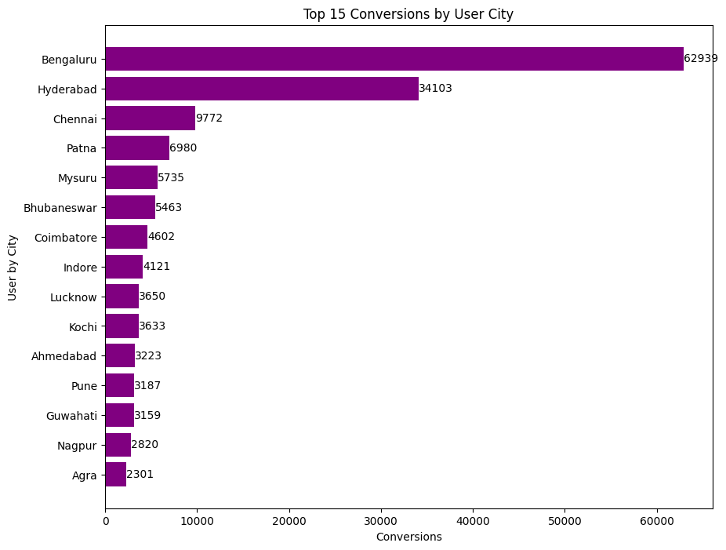
Town/City Analysis
Bengaluru has the highest number of users, new users, engaged sessions, and event count at 63K, indicating a strong user base and high engagement.
Hyderabad, Chennai, Patna, and Mysuru also show significant user numbers and engagement metrics, suggesting a strong user base and active user interaction.
Bhubaneswar, Coimbatore, Indore, and Lucknow have moderate user numbers and engagement metrics, indicating a decent level of user interaction.
Kochi, Ahmedabad, and Pune show moderate user numbers and engagement metrics, suggesting a decent level of user interaction despite lower user numbers.
Guwahati, Nagpur, and Agra have relatively low user numbers and engagement metrics, indicating a smaller user base or potentially less effective engagement strategies.

Slide 20
Recommendations
Bengaluru: Continue focusing on maintaining high engagement levels and user growth.
Hyderabad, Chennai, Patna, and Mysuru: Continue engaging with the user base to maintain or improve current engagement levels.
Bhubaneswar, Coimbatore, Indore, and Lucknow: Explore ways to increase user base and engagement.
Kochi, Ahmedabad, and Pune: Improve engagement strategies to increase interaction and retention.
Guwahati, Nagpur, and Agra: Focus on increasing user base and improving engagement strategies.

Slide 21
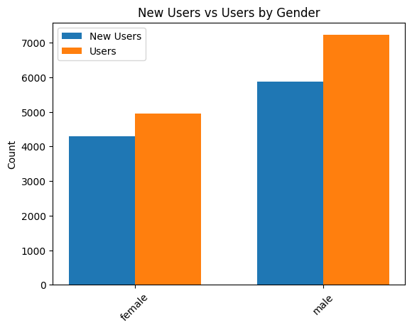
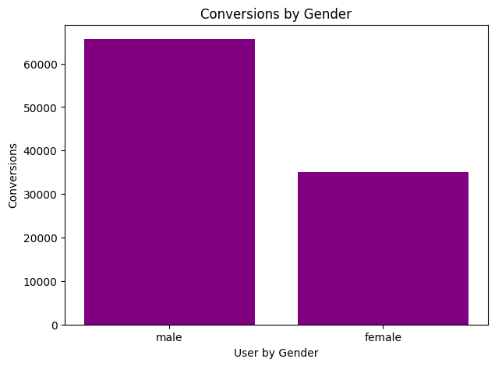
Gender Report
Users: Male users constitute 59.4% of the total users, while female users constitute 40.6%.
Engaged Sessions per User: Male users have 9.7% fewer engaged sessions per user compared to female users.
Engagement Rate: Female users have a 17.1% higher engagement rate than male users. The higher engagement rate among female users indicates their greater interest and interaction with the platform, highlighting the importance of catering to their preferences and needs.
Average Engagement Time: Female users spend 62.7% more time in engaged sessions compared to male users. The significantly higher average engagement time of female users suggests a deeper level of engagement and potential for more meaningful interactions.

Slide 22
Recommendations
Targeted Marketing: Given the higher engagement rate and longer engagement time of female users, targeted marketing efforts should be prioritized to capitalize on their interest and boost overall engagement.
Content Optimization: Understanding the content and features that resonate more with female users can help optimize the platform to better meet their preferences, leading to increased engagement and user satisfaction.

Slide 23
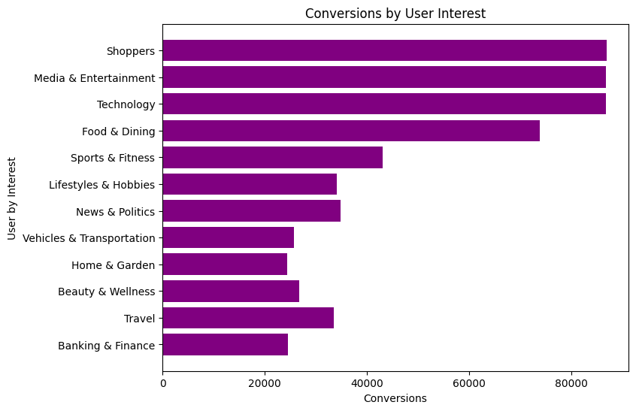
User By Interest
Food & Dining: Low conversions despite strong engagement.
Lifestyles & Hobbies: Moderate conversions with strong user engagement.
Media & Entertainment: Low conversions despite moderate engagement.
News & Politics: Low conversions with moderate engagement.
Shoppers: High conversions with strong engagement.
Sports & Fitness: Moderate conversions with good engagement.
Technology: High conversions with strong engagement.
Travel: Moderate conversions with good engagement.
Vehicles & Transportation: Low conversions despite moderate engagement.

Slide 24
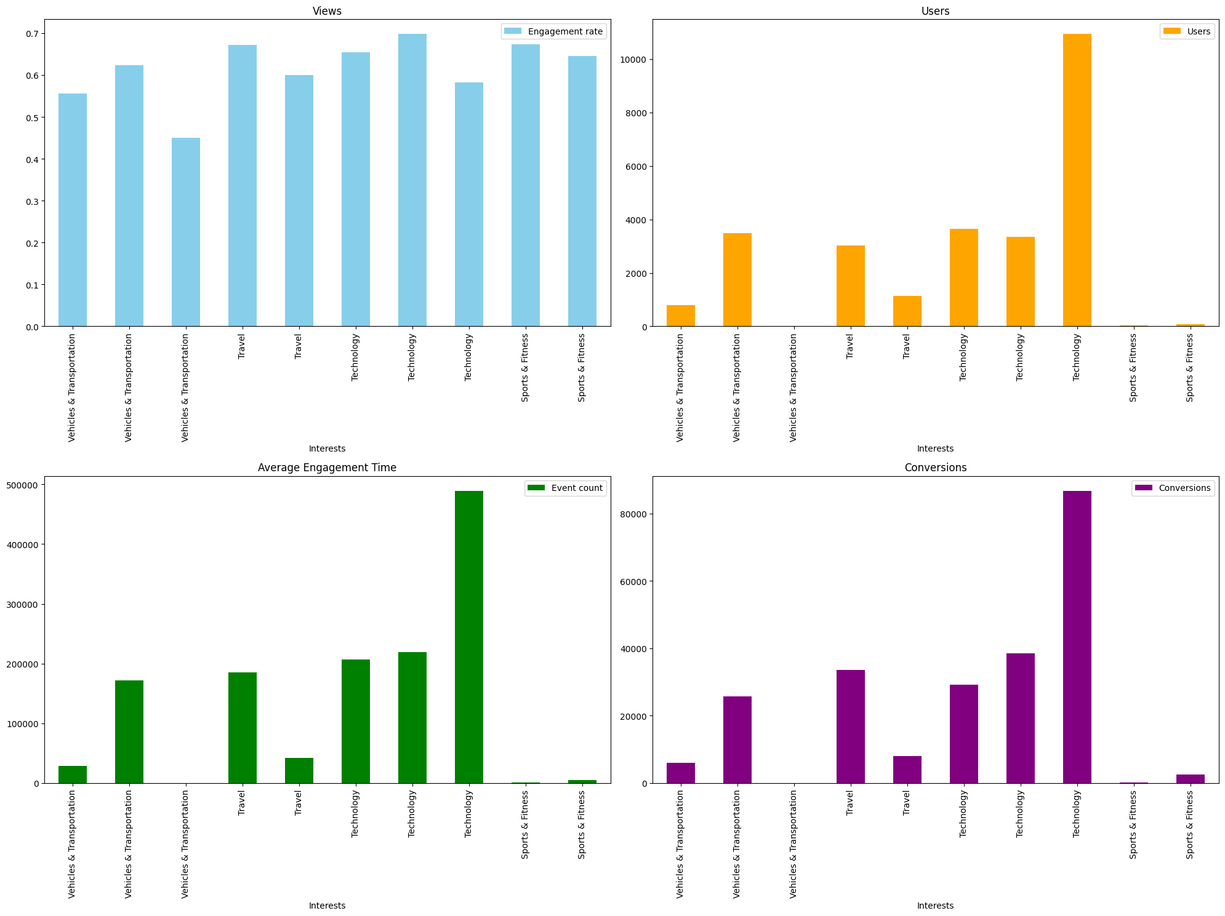
User By Interest
Media & Entertainment/Comics & Animation Fans: Conversion Rate: 17.67%,Views: 1.43
Vehicles & Transportation: Conversion Rate: 7.53%,Views: 1.28
Travel: Conversion Rate: 11.05%, Views: 1.60
Technology: Conversion Rate: 8.00%, Views: 1.58
Sports & Fitness: Conversion Rate: 7.58%, Views: 1.54

Slide 25
User By Interest
The Media & Entertainment/Comics & Animation Fans interest group stands out with a high conversion rate of 17.67%, indicating strong engagement and a high likelihood of converting among its users.
These findings suggest that the Travel interest group has the second highest conversion rate, indicating a strong engagement and likelihood to convert among its users.
However, the Technology interest group has a slightly higher view rate, indicating a broader interest in content but with slightly lower conversion. Further analysis could focus on optimizing content and campaigns for the Technology group to improve conversion rates.

Slide 26
Recommendations
Monetization Strategy: For interest groups with high engagement rates but no revenue, consider refining the monetization strategy. This could involve introducing targeted ads, sponsored content, or premium subscription options related to the specific interest.
Content Personalization: Tailor content to the specific interests and preferences of each group to enhance engagement and user experience. This could include recommending relevant products, articles, or events based on user behavior within the app.
Engagement Campaigns: Develop targeted engagement campaigns to further boost user interaction and loyalty within each interest group. This could involve offering exclusive content, discounts, or rewards for active users.
User Feedback and Insights: Collect feedback from users within each interest group to understand their needs and preferences better. Use this information to refine content strategies and improve user engagement.

Slide 27
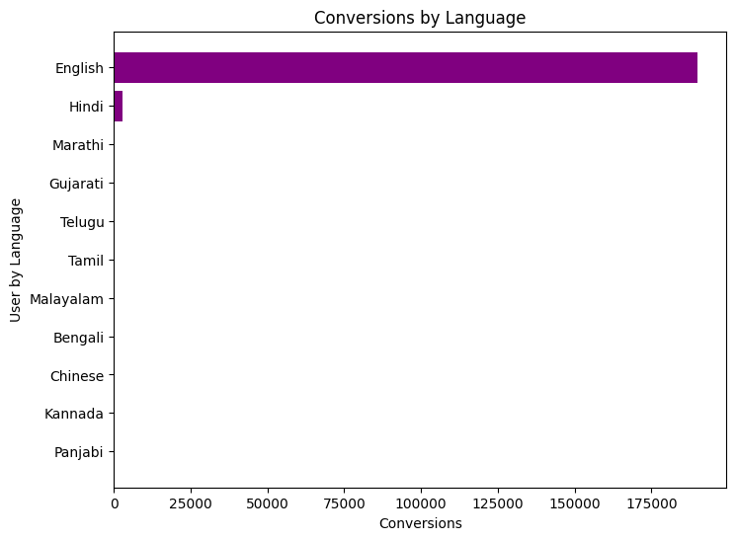
User by Language
Engagement Rate: English has the highest engagement rate at 59.5%, indicating strong user interaction. Other languages like Malayalam and Panjabi also show relatively high engagement rates, suggesting active user bases.
User Base: Hindi has the largest user base among regional languages, with 586 users. English, of course, leads overall with 22,495 users.
Engaged Sessions: English and Hindi have the highest number of engaged sessions, with English accounting for 40,639 sessions and Hindi for 798 sessions.
Average Engagement Time: Malayalam users spend the most time engaging with the app, with an average engagement time of 161.94 seconds, followed by English at 341.36 seconds.

Slide 28
Recommendations
Content Localization: Given the significant user base in languages like Hindi, Marathi, Gujarati, and others, consider localizing content to cater to these audiences better. This can include translating app content, providing localized news or updates, and incorporating culturally relevant features.
Engagement Strategies: Implement engagement strategies tailored to each language group. For example, considering the higher engagement rates in Malayalam and Panjabi, create exclusive content or features that appeal to these users to further enhance engagement.
Community Building: Foster a sense of community among users of regional languages. This can be done through forums, groups, or events that cater specifically to users of each language, encouraging user interaction and loyalty.
User Feedback: Collect feedback from users in different language groups to understand their preferences and improve the app's content and features. This can help in making data-driven decisions to enhance user experience.
Marketing and Promotion: Increase marketing efforts targeting users of regional languages to attract more users from these segments. This can include targeted advertising, partnerships with regional influencers, and promotions at local events or gatherings.

Slide 29
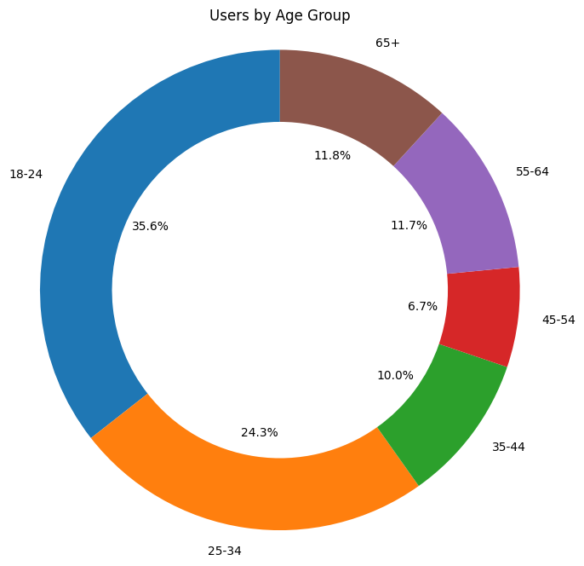
User by Age group
18-24: Highest number of users and engaged sessions. High engagement rate and sessions per user. Average engagement time is also high. Good conversion rate.
25-34: Moderate number of users and engaged sessions. Low engagement rate and sessions per user. Average engagement time is moderate. Conversion rate is lower compared to other age groups.
35-44: Moderate number of users and engaged sessions. Low engagement rate and sessions per user. Average engagement time is high. Conversion rate is moderate.
45-54: Lower number of users and engaged sessions. Moderate engagement rate and sessions per user. Average engagement time is moderate. Conversion is lower compared to other age groups.
55-64: Similar to the 65+ age group but with slightly higher user and session numbers. Conversion rate is higher than the 65+ age group.
65+: Lowest number of users and engaged sessions. Moderate engagement rate and sessions per user. Average engagement time is low. Conversion rate is low.

Slide 30
Recommendations
18-24: Continue engaging this age group with tailored content and offers to maintain high conversion rates.
25-34: Implement strategies to increase engagement and conversion rates, possibly by targeting specific interests or needs.
65+: Create content and offers that cater to the interests and needs of this age group to increase engagement and conversion rates.
55-64: Similar to the 65+ age group, focus on content and offers that resonate with this age group to improve engagement and conversions.
35-44: Continue to provide engaging content and offers to maintain moderate conversion rates.
45-54: Implement strategies to increase engagement and conversion rates, possibly by refining content and offers to better suit this age group's preferences.

Slide 31
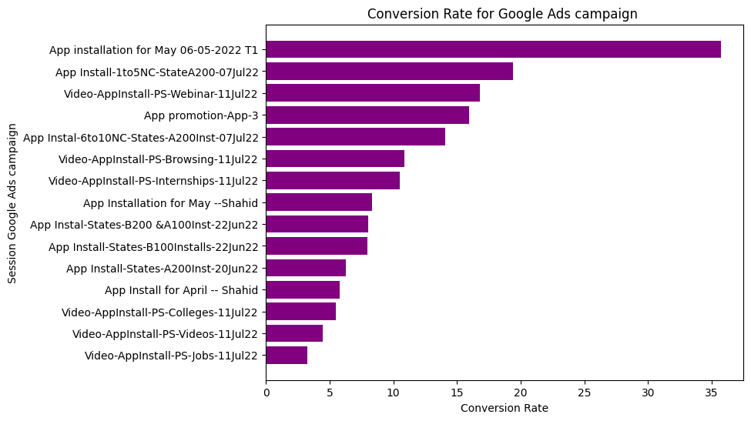
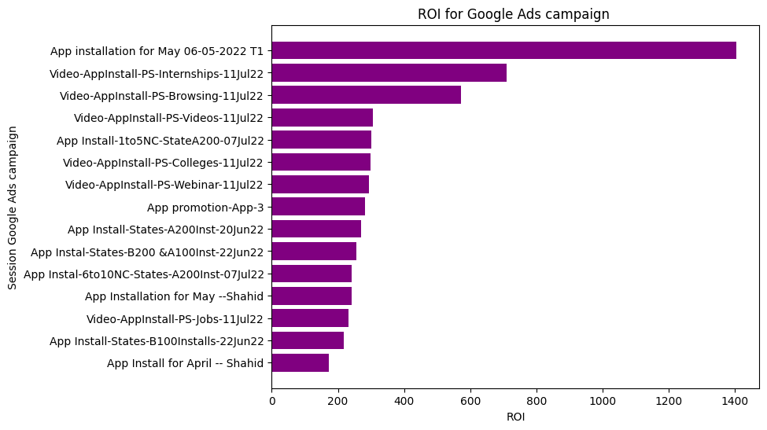
Google Ads Report
Successful Campaigns:
"App promotion-App-3": Conversion Rate - 15.92%, ROI - 281.49
"Video-AppInstall-PS-Internships-11Jul22": Conversion Rate - 10.50%, ROI - 709.05
"App Install-1to5NC-StateA200-07Jul22": Conversion Rate - 19.38%, ROI - 301.03
Moderate Performers:
"App Install-States-A200Inst-20Jun22": Conversion Rate - 6.24%, ROI - 268.99
"App Install for April -- Shahid": Conversion Rate - 5.78%, ROI - 171.62
Underperforming Campaigns:
"Video-AppInstall-PS-Jobs-11Jul22": Conversion Rate - 3.21%, ROI - 231.21
"Video-AppInstall-PS-Videos-11Jul22": Conversion Rate - 4.45%, ROI - 306.10

Slide 32
Recommendations
Optimize Successful Campaigns: Allocate more budget and resources to campaigns with high conversion rates and ROI, such as "App promotion-App-3" and "Video-AppInstall-PS-Internships-11Jul22".
Refine Targeting: Analyze successful state-specific campaigns like "App Install-States-A200Inst-20Jun22" and "App Install-States-B100Installs-22Jun22" to refine targeting strategies for other campaigns.
Explore New Platforms: Consider expanding campaigns to new platforms or channels based on the success of campaigns like "Video-AppInstall-PS-Browsing-11Jul22".
Content Optimization: Continuously optimize ad content and messaging based on the success of campaigns like "Video-AppInstall-PS-Webinar-11Jul22" and "Video-AppInstall-PS-Colleges-11Jul22" to improve overall performance.
Seasonal Campaigns: Plan seasonal campaigns like "App installation for May 06-05-2022 T1" with high conversion rates for maximum impact.

Slide 33
Key Findings
Identified top-performing user acquisition channels.
Analyzed user engagement metrics and identified areas for improvement.
Studied conversion rates and suggested strategies for optimization.
Evaluated the performance of Google Ads campaigns and recommended improvements.
Recommendations
Optimize user acquisition channels based on performance data.
Enhance user engagement by improving the user experience.
Focus on conversion rate optimization to increase installations.
Further optimize Google Ads campaigns to improve ROI.

Slide 34
Things to be considered
Based on the exploration of the dataset provided, several aspects should be considered:
Low User Engagement: Some user segments and interests show low engagement rates and session durations. This indicates that certain demographics or content categories may not be resonating well with users, leading to potential churn and reduced user satisfaction.
Underperforming Campaigns: Certain Google Ads campaigns exhibit low conversion rates and ROI. This suggests that these campaigns may not be effectively targeting the right audience or delivering compelling messaging, resulting in wasted ad spend and inefficient marketing efforts.
Limited Market Reach: The dataset reveals that some campaigns and user segments have limited reach and impact. This could indicate a narrow audience base or ineffective marketing channels, potentially hindering the app or website's growth potential.

Slide 35
Uneven Performance Across Demographics: Variations in user engagement, conversion rates, and revenue across different demographics and interests highlight potential disparities in the website's appeal. Failing to address these disparities could lead to missed opportunities and limited audience growth.
Overreliance on Specific Channels: The dataset shows a significant portion of revenue and conversions attributed to specific user acquisition channels. Overreliance on these channels without diversification can make the app or website vulnerable to changes in those channels' effectiveness or policies.
Lack of Long-Term Strategy: While the dataset provides insights into short-term performance metrics, such as conversion rates and engagement, it's essential to develop a long-term strategy for sustainable growth and user retention. Focusing solely on short-term gains could result in neglecting long-term user engagement efforts.
Addressing these negative aspects requires a comprehensive approach that includes refining targeting strategies, improving user experience, diversifying marketing channels, ensuring data privacy compliance, and developing a robust long-term growth strategy.

Slide 36
Next Steps
Implement recommended changes based on the analysis.
Monitor the impact of these changes on user installations and engagement.
Continuously analyze and optimize user data to improve overall performance.
Explore new strategies to further enhance user acquisition and engagement.

Slide 37
Thank you
Regards,
Muthukumaran A

